Slide 1
Information from the Autumn County Chairs Seminar 2024

Slide 2
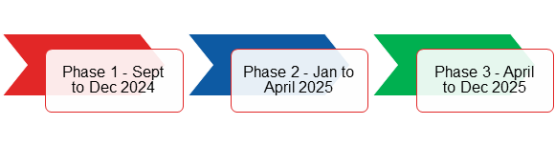
Developing our Organisational Strategy
The process of agreeing an intense focus on a small number of long-term priorities that allow us to realise our mission and deliver value to the armed forces community in a crowded landscape
RBL is developing a new 10-year strategy
To ensure RBL is fit for the future
Influenced by RBL’s many stakeholders
Developments presented to County Chairs in March
Formally presented at Annual Conference 2025

Slide 3
Strategy: What we’ll deliver
The outputs the strategy work will provide:
A statement of RBL’s purpose, vision, mission and values
An assessment of RBL’s current capabilities and gaps
A 10-year strategy document
A financial model
Agreed strategic goals
Key performance indicators (KPIs) to evaluate impact
Business and people plans to support the delivery of the strategy

Slide 4
Strategy: How you can help
The strategy must be informed by the current and future needs of the Armed Forces community.
Make your voices heard
Ensure members know we’re developing a new strategy
A member survey will go live in late September to enable all members to share their thoughts and help shape the strategy.

Slide 5
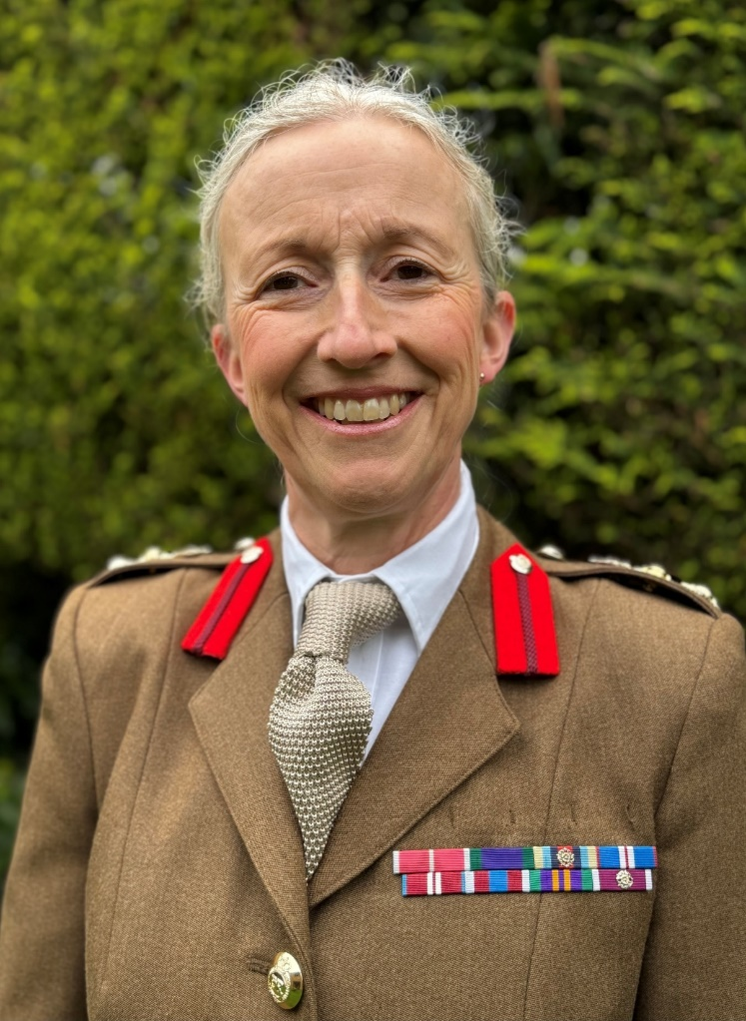
Chief of Staff Introduction
Colonel (retd) Clare Waterworth MBE introduced herself and her role at RBL:
Joined RBL straight after leaving the army
30 years’ regular service, serving across the world, living in military housing
Last role in welfare support at MoD, knows her way around Whitehall
Will be running RBL’s 2024/5 elections, and is leading RBL’s strategy work
Approach to strategy will mean regular consulting, engagement and input from membership
Honoured to join RBL – please invite her to visit your branches and counties

Slide 6
RBL SWOT Analysis
To inform the strategy development, County Chairs took part in breakout sessions to identify RBL’s:
Strengths – positive tangible and intangible attributes, internal to an organisation and within the organisation’s control
Weaknesses – internal factors within an organisation’s control that detract from the organisation’s ability to attain the desired goal
Opportunities – external attractive factors that represent the reason for an organisation to exist and develop. What opportunities exist in the environment which will propel the organisation?
Threats – external factors beyond the organisation’s control which could place the organisation’s mission or operation at risk

Slide 7
SWOT feedback
Key strengths
Strong lobbying and campaigning ability - results
100 years of reputation, respect – the poppy
Royal patronage, prestige
Passionate membership, supporters
Key weaknesses
Communication gaps
Large org. size – reaction time
Lack of coherent decision making
Aging volunteers, membership
Camaraderie – knowing what it means to serve
Our dedicated volunteers
Strong fundraising abilities
Branches embedded in communities
Bureaucracy
Armed Forces not understanding RBL’s role
Staff turnover
Perception RBL is only there in November

Slide 8
SWOT feedback
Key opportunities
Engagement - with Armed Forces and the public
Youth affiliations
Data insights – identify priorities and focus
Utilising skills/knowledge of membership
Key threats
Lack of single focus or vision
Aging and declining membership
Shrinking veteran population
Regulatory environment
Communication, marketing – storytelling,
Unlocking of branch funds
Sharing best practice between branches
Act as a conduit for all military charities
Public perception – public unaware of what we do
Misrepresentation/misinformation about RBL
Other armed forces charities moving in
Staying relevant – 100 years old

Slide 9
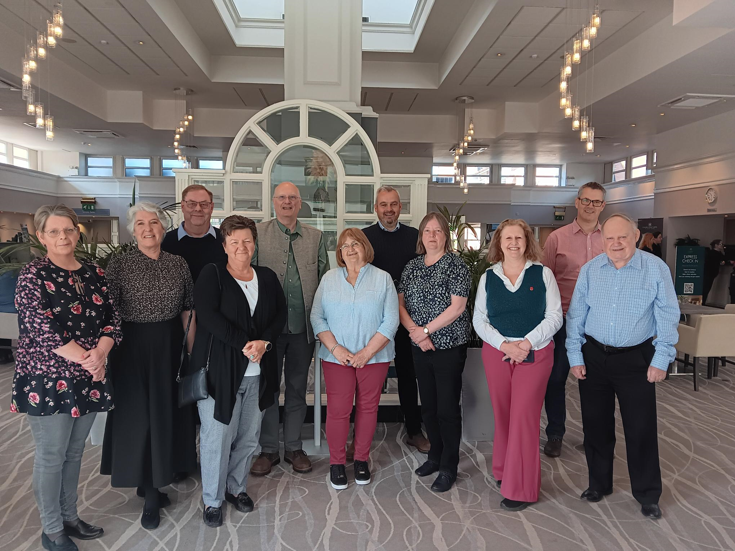
The Newport Agreement
The Newport Agreement was introduced by Emma Cox, Women’s Section MC Rep, and Liz Butler, Trustee:
Developed by representatives of the Board of Trustees, Membership Council and Executive Board
Sets standards and commitments for how to work together
RBL’s version of the Nolan Principles (Seven Principles of Public Life which apply to anyone who works as a public office holder)
County Chairs were asked to read the agreement, to discuss it in groups, and feed back their thoughts on how to implement it.
Further detail on the agreement and how it will be implemented will be communicated in due course

Slide 10
Elections Update
The Membership Council Chair spoke about RBL’s upcoming Membership Council and National Officer elections, encouraging people to put themselves forward:
Elections are at the heart of RBL membership
Twelve MC Reps, National Chair, National Vice Chair and three Trustees up for election
Elections information will be shared very soon
Members should not be put off by the competency requirements for the roles
Members were encouraged to consider their transferable skills or to find a mentor
We want more people to feel encouraged to put themselves forward

Slide 11
Key Membership Improvements
Delivered:
Annual Conference 2024 – ‘Gold Standard’
Membership Services – transferred to Customer Operations team (Nina Villa)
Single touchpoint into membership for enquiries – better response rate, tracking trends
Beacon Branches test pilot underway
Centenarian Membership rollout
New BCS materials & Network
In progress:
Communications & engagement review
Clubs platform
Membership Engagement Team Review action plan
Youth membership/affiliation
Family membership
Good County and Branch Guides
BCS ID cards
Local Resolution pack

Slide 12
RBL.Community accounts
What are we doing?
Moving to rbl.community email addresses for County & Branch Officers in approved roles (12,000)
Phased roll out – end of September 2024
Training, communications and support delivered alongside
Why are we doing it?
Data protection
Data management
Mitigate risks
Keep members safe
Support rollout of internet banking

Slide 13
Internet Banking
Lloyds Bank offers a solution for Internet Banking. This has been successfully adopted by a small number of branches as part of a pilot. Internet Banking is optional, not mandatory.
Rollout Phases:
Counties: October – December 2024
Branches: Early 2025
Criteria: All Counties and Branches wishing to apply must be compliant.
Account: Counties and Branches with accounts at other banks will need to switch over to Lloyds Treasurers Account.
Bank Mandates: Counties and Branches should ensure their Bank Mandates are up to date and signatories are using RBL.Community email addresses.

Slide 14
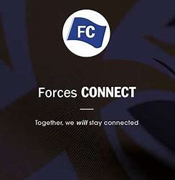
Free app supports the Armed Forces Community
The Forces Connect App links the armed forces community to local and national organisations offering help and support across a wide range of services.
From crisis support to searching for a dentist, starting a business, to advice on housing – just a few simple clicks will provide with details for relevant organisations. There are no charges or adverts, and you will not be asked for any personal information.
If you or a family member is serving, has served, or if you support members of the Armed Forces community, the free Forces Connect app is designed for you.
Download the mobile app by searching Forces Connect in the Apple app or Google Play store or access the web version via www.forcesconnect.co.uk

Slide 15








RBL Services: The Year So Far
Over 12,000 requests for financial help so far this year
909 Urgent support cases so far this year
Currently supporting 6,938 households with welfare support
Average 130 new enquiries a day for welfare support
BDMA £9.66M uplift
Last Updated
6.3 days
Waiting Times
4.6 days
Average Caseload
27
Down from 23 in Q2
Averages across Service
Average time from point of referral to meaningful contact.
No Q2 data. Excl. Urgent
Down from 31 in Q2

Slide 16
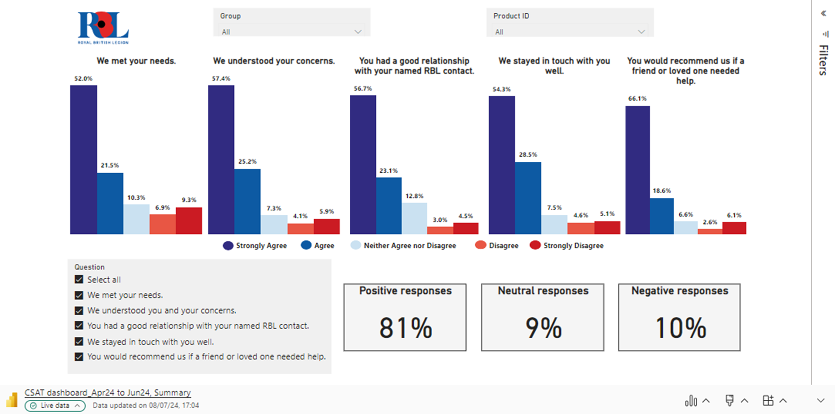
RBL Services: How are we performing?

Slide 17
Beneficiary feedback video
https://trbl.sharepoint.com/:v:/s/Events/EZ7o4kGOaLpIt_eqXEqQBEwBjI1Rim302fbOIdYxkSggjg?e=QheDKC

Slide 18
Diary Dates
Membership Meet Ups: Midlands - 30th Nov – National Memorial Arboretum

