Slide 1
ROYAL BRITISH LEGION Benefits, Debt and Money Advice Service

Slide 2
RBL ELIGIBILITY
Currently serving and ex-service personnel who have received one day of pay.
Spouses/Partners (including widows/widowers).
Any person who is financially dependent on a beneficiary.
Any person who is dependent for care from a beneficiary, or the spouse of a beneficiary. This includes adults or children.
Any person whom a beneficiary is dependent on for care.

Slide 3
BDMA – Structure
Team of 25 Specialist Benefits & Debt Advisers.
Split into 5 Regions:
Jennie Anderson – Head of Welfare, BDMA
Claire Marsh – North – Region 4
Beth Dowson - North Midlands – Region 3
Gavin Allen - South Midlands & Wales – Region 2
Philip Monk – South – Region 1
Jim Henderson – Scotland – Region 5

Slide 4
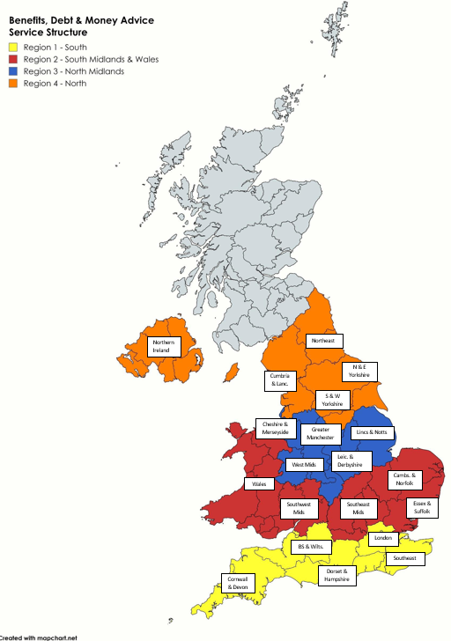

Slide 5
BDMA Criteria
Income Maximisation - for beneficiaries in crisis with zero income and/or vulnerable beneficiaries with complex benefit overlaps which require BDMA input, for a more specialist benefit check and advice.
Welfare Benefits - Mandatory Reconsiderations and Appeal & Representation - A beneficiary must have made a claim for a benefit, received a decision they disagree with and require support to challenge the decision. We can support with providing advice on merit, gathering medical evidence, in some cases achieving outcomes without the need for tribunal attendance and preparing/representing at tribunals.
Debt Advice - The BDMA service supports beneficiaries with priority & non-priority debts, or nonpriority debts only (in the absence of priority debt) where vulnerabilities are a barrier to accessing an external advice agency for support. The Service provides holistic, non-judgemental advice on a range of debt options including insolvency and can enter beneficiaries into Breathing Space application to protect from creditor enforcement action.

Slide 6

DEBT
Priority Debts, most common:
Rent / Mortgage Arrears;
Council Tax – inc. Court Action and Enforcement Officers;
Gas & Electric Arrears;
Court Fines.
Court Representation;
Grant Recommendations;
Debt Management / Solutions:
Debt Relief Orders;
Bankruptcy Petitions;
Repayment plans;
Negotiating with Creditors / Landlords / Local Authorities / DWP…..

Slide 7
BENEFITS
Wide range of Benefit Advice and Assistance is in scope from general advice to Appeals;
We assist from the Mandatory Reconsideration stage
Carry out a Face-to-Face or telephone appointment, to take instructions;
Review the evidence bundle, request medical evidence, draft detailed submission;
Represent beneficiary at the Tribunal – wherever that may be.

Slide 8
We can consider a range of grants to support you to achieve the changes you are trying to make, and include
Urgent situations where you need food or clothing.
Help with rental deposits and rent in advance.
Essential repairs and maintenance to your home.
Cost of living, such as with your energy costs and making your home more energy efficient.
Essential household good and carpets.
Supporting you to undertake activities to tackle social isolation.
Occupational Therapy assessments and support with mobility aids like riser recliners, specialist beds or mobility scooters.
adaptations to your home, so that you can retain independence.
Helping with funeral costs for a loved one and we can offer guidance on other bereavement support available.
Support to access the digital world; providing internet access and with equipment and training to get you on-line.
Linking you in with our employment partners to find work or change career and we can consider the cost of courses or equipment that you may need.
Assisting with unexpected travel costs.
Notes:
Discuss how this is not an exhaustive list – there is no list of what we can and cannot do. We work on need and trying to support someone to live a fulfilled life. We seek to understand what is needed and why and look to support with it. There is no need to get into weeds of financial eligibility criteria here. If you do touch on that, just discuss how we work with beneficiaries to help them meet their own needs. Sometimes people cannot do this without some financial support. When that is needed, we are here to provide it.

Slide 9
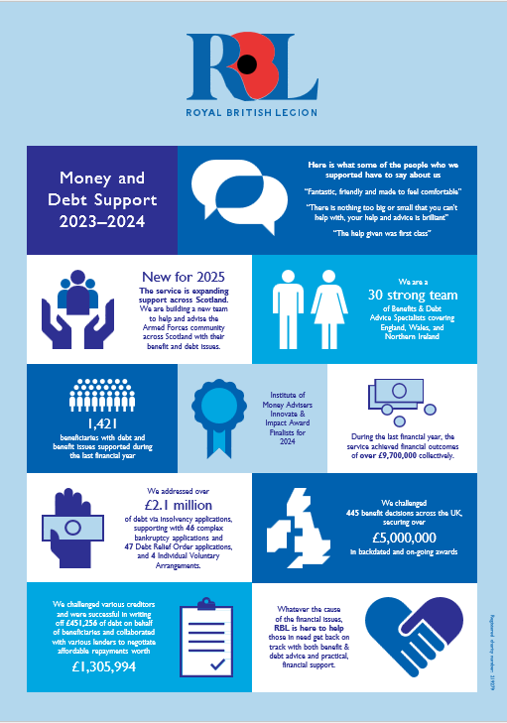

Slide 10
Child Maintenance Service Case Example
A beneficiary had a large amount of Child Maintenance Arrears that he disputed. The Child Maintenance Service (CMS) were also making large deductions from his wages that were not affordable. In terms of dealing with CMS, it was very difficult. It took them a long time to accept our Form of Authority, even with the Adviser adding themselves as the representative on his case. The Adviser then had to wait for a letter to confirm this had been done and be provided with a specific reference number but when this came, the CMS gave me the wrong details and then wouldn’t speak with the Adviser at all!
The Adviser then tried to add information to his case online and they attached a copy of his financial statement showing that he could not afford the deductions that were being made and with a new offer of repayment, but the Adviser never got a response to this. The case lasted for well over a year with now real movement, before the Adviser lost contact with the beneficiary as we are sure the beneficiary got fed up waiting for this matter to be resolved.

Slide 11
Department for Work and Pensions - Case Examples
Universal Credit Overpayment
The beneficiary served in the Army from 1988 to 2005 and was medically discharged.
The beneficiary was in receipt of a War Pension, Mobility Supplement , a Service Attributable Pension and Personal Independence Payment
The case went to a Tribunal appeal and the appeal was allowed and the DWP was ordered to pay back the full amount taken from beneficiary for the UC overpayment.
However, the DWP did not refund the full amount they owed beneficiary until we sent them a pre-action protocol letter
We involved the DWP Armed Forces Champion and eventually the DWP AFC Manager for the Northwest to escalate this.
We also involved the Child Poverty Action Group Judicial Review Project for advice and guidance
Eventually the total amount was repaid to the beneficiary which was over £7,000
It took 2 years to get this resolved - from 10/2/22 to 14/3/24.

Slide 12
HMRC Case Examples
A beneficiary had an overpayment of Tax Credits.
HMRC refused to work with us, despite completing the necessary forms.
The beneficiary became unable to work due to awaiting an operation.
The beneficiary claimed Statutory Sick Pay then claimed Universal Credit and was issued with the Overpayment decision.
We involved the DWP Armed Forces Champion Manager for the Northwest to escalate this.
We also involved the Child Poverty Action Group Judicial Review Project for advice and guidance
The DWP agreed to not recover the overpayment and the DWP repaid the beneficiary £4103.
It was discovered that the DWP owed him £756.45 for an underpayment so if we hadn’t challenged the Overpayment this never would have been discovered!
It took from 2/11/23 to 2/9/24 to get this resolved

Slide 13
Beneficiary Feedback
“My needs were surpassed, will be eternity grateful for what was done.”
“Absolutely great . We have built a very trustworthy relationship, and I don’t know what I would have done without her.”
“British Legion team were fantastic very professional and courteous.”
“Feel like the team know what I need and listen to my situation and don't judge or assume and take into consideration all my experiences and worries.”
“I’d recommend that any veteran that’s finding life difficult to reach out to you.”
“The RBL were brilliant at understanding my needs, maintaining professionalism throughout. Never judgemental, always willing to help.”

Slide 14
Royal British Legion Campaign
The Credit Their Service campaign
The treatment of military compensation in means tests for welfare benefits can result in injured veterans or bereaved families being ineligible for certain benefits or cause them to use their compensation payments to cover everyday living costs. Consequently, this may impact on their physical and mental wellbeing, access to housing and households’ financial resilience.
Our recommendation is that compensation and payments awarded for illness, injury or death as a result of Service should never be treated as normal income. The Government should ensure that no statutory means test treats War Disablement Pensions, Armed Forces Compensation Scheme Guaranteed Income Payments and Service Invaliding or Service Attributable Payments, as normal income. Local authorities should use their discretionary powers to ensure that means-testing policies for locally administered benefits disregard military compensation payments in full.

